Slide 1



Python 3 Beginner
Chapter 00
Previously, on Python 3 Beginner…
release 1.0.0
37/39 Avenue Ledru Rollin – CS 11237 – 75750 PARIS CEDEX 12 - info@valnaos.com – www.valnaos.com Tél : 01 86 95 20 48

Slide 2

What we saw last time
Python 3 Beginner
Learning

Slide 3

Cloud Technology Associate
Copyright © 2018 | 9
Q&A
37/39 Avenue Ledru Rollin – CS 11237 – 75750 PARIS CEDEX 12 - info@valnaos.com – www.valnaos.com Tél : 01 86 95 20 48

Slide 4

Where? Who?
Python 3 Beginner
Class Material
GitHub: https://github.com/cstar-industries/python-3-beginner
Instructor
Charles Francoise <charles@cstar.io>

Slide 5

Session Objectives
Python 3 Beginner
At the end of this session, you will be able to:
Define

Slide 6
Session Syllabus
Python 3 Beginner
Chapter | Subject | Start | End | Total Time (in hours)
00 | Previously on Python 3 Beginner… | 14:00 | 14:15 | 00:15
01 | Functions: Part I | 14:15 | 15:00 | 00:45
 | Coffee Break | 15:00 | 15:10 | 00:10
02 | Functions: Part II | 15:10 | 15:55 | 00:45
 | Coffee Break | 15:55 | 16:05 | 00:10
03 | Generators and Error Handling | 16:05 | 16:50 | 00:45
 | Coffee Break | 16:50 | 17:00 | 00:10
 | Workshop | 17:00 | 18:00 | 01:00
 | Total |  |  | 04:00

Slide 7
Python 3 Beginner
Chapter 01
HTTP with Requests
release 1.0.0
37/39 Avenue Ledru Rollin – CS 11237 – 75750 PARIS CEDEX 12 - info@valnaos.com – www.valnaos.com Tél : 01 86 95 20 48

Slide 8
Requests
Python 3 Beginner
Requests is a library that makes HTTP requests very simple, while still providing powerful in-depth options
"HTTP for Humans"
Perfect for downloading/uploading data, or communicating with a web service API

Slide 9
Requests
Python 3 Beginner
HTTP in a nutshell
GET / HTTP/1.1
Accept: */*
Accept-Encoding: gzip, deflate
Connection: keep-alive
Host: www.google.com
User-Agent: HTTPie/1.0.2
HTTP/1.1 200 OK
Cache-Control: private, max-age=0
Content-Encoding: gzip
Content-Type: text/html; charset=ISO-8859-1
Date: Tue, 12 May 2020 08:34:48 GMT
Expires: -1
Server: gws
Set-Cookie: 1P_JAR=2020-05-12-08; expires=Thu, 11-Jun-2020 08:34:48 GMT; path=/; domain=.google.com; Secure
Transfer-Encoding: chunked
<!doctype html><html itemscope="" itemtype="http://schema.org/WebPage" lang="fr"><head> <meta content="text/html; charset=UTF-8" http-equiv="Content-Type"><meta content="/images/branding/googleg/1x/googleg_standard_color_128dp.png" itemprop="image"><title>Google</title>...

Slide 10
Requests
Python 3 Beginner
requests.get sends a GET request
Returns a Response object with info about the data
res = requests.get('https://google.com')
print(res.ok)
print(res.status_code)
print(res.reason)
print(res.elapsed)
True
200
OK
0:00:00.085902

Slide 11
Requests
Python 3 Beginner
The response content is available in several forms
type(res.text)
type(res.content)
str
bytes
Parse a JSON response directly to a dict
type(res.json())
dict

Slide 12
Requests
Python 3 Beginner
Read the response headers in dict form
print(res.headers)
{'Date': 'Tue, 12 May 2020 10:00:57 GMT',
'Expires': '-1',
'Cache-Control': 'private, max-age=0',
'Content-Type': 'text/html; charset=ISO-8859-1
...
Parse a JSON response directly to a dict
type(res.json())
dict

Slide 13
Requests
Python 3 Beginner
Raise a Python error on HTTP errors
res = requests.get('https://google.com/toto')
print(res.ok)
print(f'{res.status_code} {res.reason}')
res.raise_for_status()
False
404 Not Found
HTTPError: 404 Client Error: Not Found for url: https://google.com/toto
Other HTTP methods are available
res = requests.post('https://httpbin.org/post', data=...
res = requests.put('https://httpbin.org/post', data=...
res = requests.delete(...
res = requests.head(...
res = requests.request('GET', 'https://...

Slide 14
Requests
Python 3 Beginner
Send query variables with params
res = requests.get('https://www.google.com/search',
params={'q':'Hello World'})
print(res.url)
https://www.google.com/search?q=Hello+World
Send data in request body with data
res = requests.post('https://httpbin.org/post',
data=b'Hello World!')
res = requests.post('https://httpbin.org/post',
data={'hello': 'world', 'search': 'python'})
print(res.request.body)
hello=world&search=python

Slide 15
Requests
Python 3 Beginner
Encode request data as JSON
res = requests.post('https://httpbin.org/post',
json={'hello': 'world', 'python': None})
print(res.request.body)
b'{"hello": "world", "python": null}'
Send file attachments
with open('profile_pic.png', 'rb') as f:
res = requests.post('https://httpbin.org/post',
files={'upload': f})
len(res.request.body)
669525

Slide 16
Requests
Python 3 Beginner
Customize request headers
res = requests.get('https://httpbin.org/post',
headers={'Authorization': 'alibaba:opensesame'})
print(res.request.body)
b'{"hello": "world", "python": null}'
Set request timeout
res = requests.get('https://www.google.com', timeout=0.001)
ConnectTimeout: 'Connection to www.google.com timed out. (connect timeout=0.001)'))

Slide 17
Python 3 Beginner
Chapter 02
Web Applications with Flask
release 1.0.0
37/39 Avenue Ledru Rollin – CS 11237 – 75750 PARIS CEDEX 12 - info@valnaos.com – www.valnaos.com Tél : 01 86 95 20 48

Slide 18
Flask
Python 3 Beginner
Flask is a micro-framework for building web applications
Use Flask to build web servers simply and efficiently without worrying about low-level details
Flask is perfect to build web applications with a JSON-based REST API
Use Flask wherever you would use PHP, Node.js or other non-Python backend technology

Slide 19
Requests
Python 3 Beginner
from flask import Flask
Write a simple Flask server
FLASK_ENV=development FLASK_APP=main.py flask run
By default, only GET is supported by your route definitions
Use methods argument in the decorator
@app.route('/', methods=['GET', 'POST'])
def index():
return 'Hello World!'

Slide 20
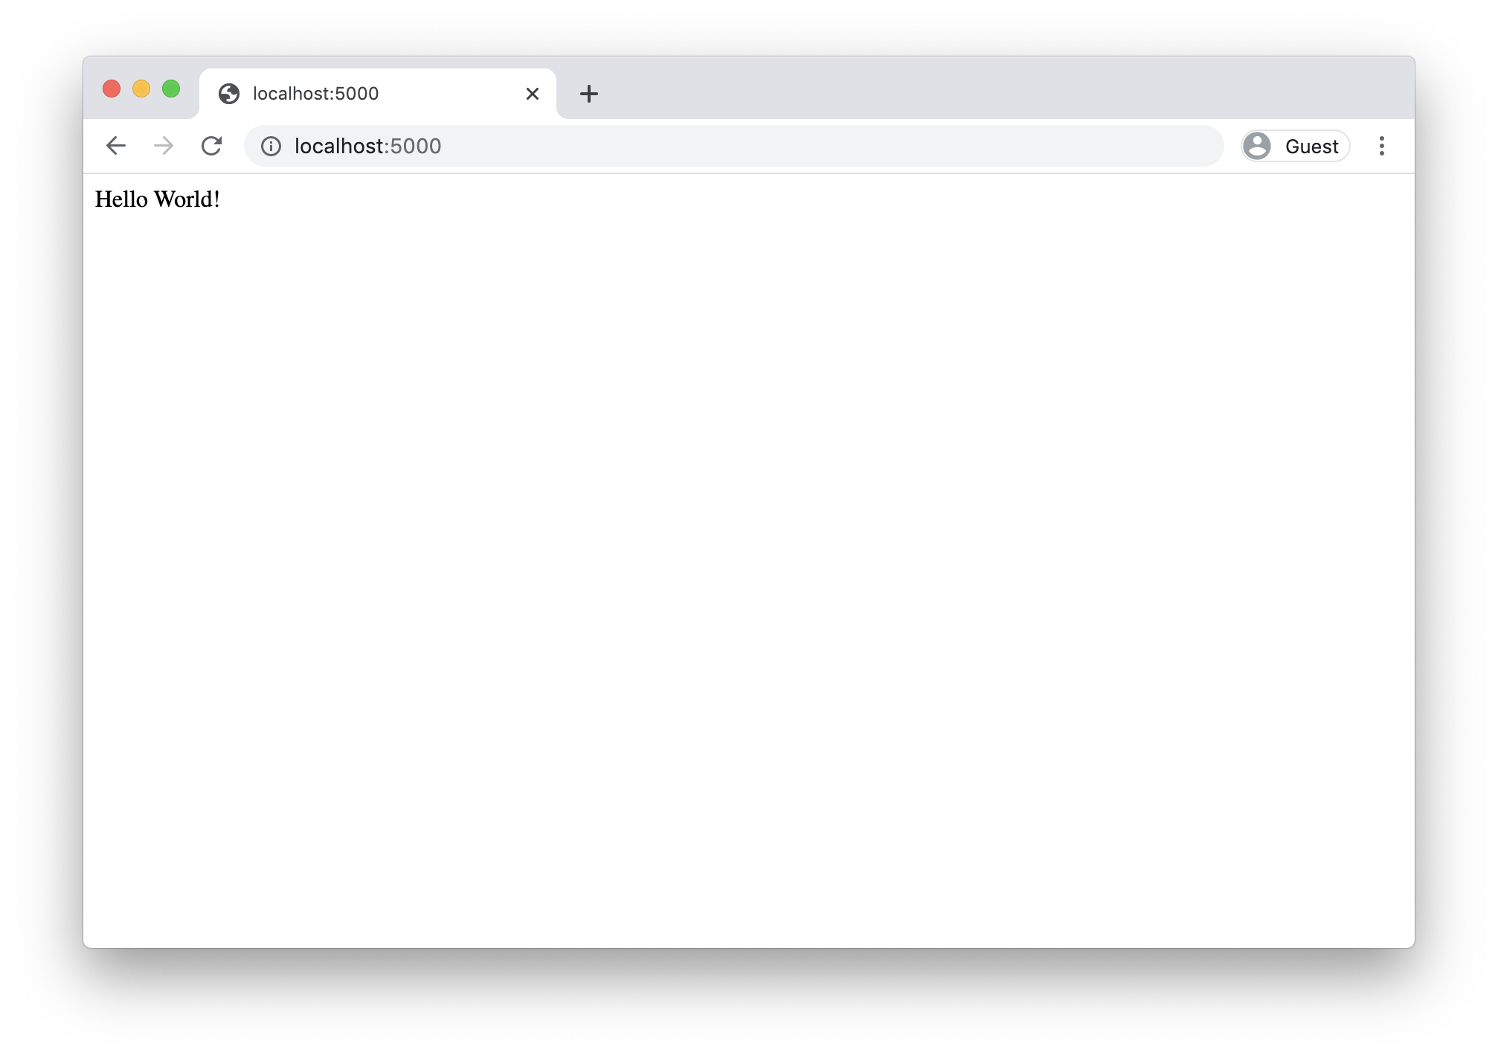
Flask
Python 3 Beginner
127.0.0.1 - - [12/May/2020 17:35:32] "GET / HTTP/1.1" 200 -
127.0.0.1 - - [12/May/2020 17:35:32] "GET /favicon.ico HTTP/1.1" 404 -

Slide 21
Requests
Python 3 Beginner
Run Flask in debug mode:
Extra info in response on errors
Automatic reload whan a file changes
FLASK_ENV=development FLASK_APP=main.py flask run
By default, only GET is supported by your route definitions
Use methods argument in the decorator
@app.route('/', methods=['GET', 'POST'])
def index():
return 'Hello World!'

Slide 22
Requests
Python 3 Beginner
Run Flask in debug mode:
Extra info in response on errors
Automatic reload whan a file changes
FLASK_ENV=development FLASK_APP=main.py flask run
By default, only GET is supported by your route definitions
Use methods argument in the decorator
@app.route('/', methods=['GET', 'POST'])
def index():
return 'Hello World!'

Slide 23
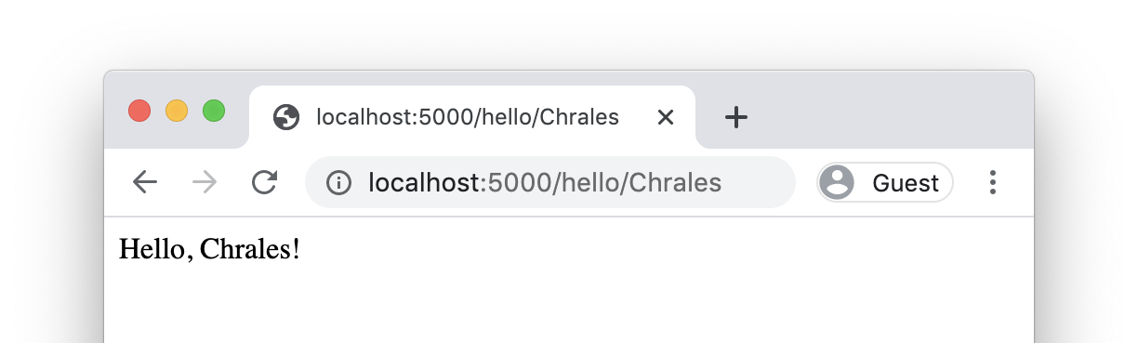
Requests: Defining routes
Python 3 Beginner
Define more routes with the route decorator
@app.route('/hello')
def hello():
return '<html><body>Hello</body></html>'
Capture variables from the address
@app.route('/hello/<name>')
def hello(name):
return f'<html><body>Hello, {name}!</body></html>'

Slide 24
Requests: Retrieving data from request
Python 3 Beginner
from flask import Flask, request
To access parameters submitted in the URL (?key=value), use the args attribute:
@app.route('/search')
def hello():
search_params = request.args.get('q')
return f'No results found for "{q}".'

Slide 25
Requests: Retrieving data from request
Python 3 Beginner
The raw request body can be read inside the handler
req_body = request.data
Request data can be parsed automatically
request.form # Form-encoded request data, parsed to a dict
request.json # JSON-encoded request data, parsed to a dict
request.files # A dict of files from multipart form-encoded data
request.headers # A dict of headers from the client request
request.cookies # A dict of cookies from the client request
...

Slide 26
Requests: Customizing the response
Python 3 Beginner
The raw request body can be read inside the handler
req_body = request.data
Request data can be parsed automatically
request.form # Form-encoded request data, parsed to a dict
request.json # JSON-encoded request data, parsed to a dict
request.files # A dict of files from multipart form-encoded data
request.headers # A dict of headers from the client request
request.cookies # A dict of cookies from the client request
...

Slide 27
Python 3 Beginner
Chapter 03
Manipulating images with Pillow
release 1.0.0
37/39 Avenue Ledru Rollin – CS 11237 – 75750 PARIS CEDEX 12 - info@valnaos.com – www.valnaos.com Tél : 01 86 95 20 48

Slide 28
Pillow
Python 3 Beginner
Pillow is a powerful library for opening, manipulating and creating all types of image files
Open-source fork of a historical Python library: PIL
Opens all types of images including JPEG, PNG, TIFF, BMP, TGA, PDF...
Allows geometrical transformations, pixel manipulation, channel operations, drawing, writing text...

Slide 29
Cloud Technology Associate
Copyright © 2018 | 9
Q&A
37/39 Avenue Ledru Rollin – CS 11237 – 75750 PARIS CEDEX 12 - info@valnaos.com – www.valnaos.com Tél : 01 86 95 20 48

Slide 30
Workshop
Python 3 Beginner
Notes:
https://github.com/cstar-industries/python-3-beginner/blob/master/001-First-Steps/First%20Steps%20-%20Workshop.ipynb

Slide 31
Thank you for your attention!

